Slide 1
Anusha’s Supermarket
By Faraz Ghani
The 2nd Smester project for Object Oriented Programming class of Software Engineering of 21SW081

Slide 2
What is Anusha’s Supermarket?
By 21SW081
This program is a simulation of a shopping application where we can order various items ranging from clothes, food and jewellery.
This program has items from different brand with which Anusha’s Supermarket is not affiliated with since this is just a simulation of user experience.

Slide 3
Classes used
Main.java | This Class makes sure that the Sign up page is brought up first to the user.
Signin_Up.java | This Class is used for creating the Sign in or up java GUI.
Customer_UI.java | This Class provides the user inteface and options for all the items avaialbe for purchase.
Pant,Shirt,Jewellery,Edible.java | These Classes provide the user inteface and options for individual categories of items for purchase.
Cartthread.java | This is a thread that saves the items added to cart along with their prices and amounts.
Cart.java | This Class provides the option for clearing the cart or purchasing the items added to cart, while showing the total price of the cart.
SendMail.java | This Class is responsible for creating the receipt and sending it to the appropiate email provided during the registration phase.

Slide 4
Main Focus of Functions
01
02
03
04
Usability
Security
This Program is easy to use and understand due to easy GUI.
JSON file paired with a login system is used for secure purchases
Threading
Beauty
Panels are used instead of buttons in order to add to the aesthetic of the User Inteface
Sendmail Makes sure the user doesn’t have to wait for email to be sent to continue

Slide 5
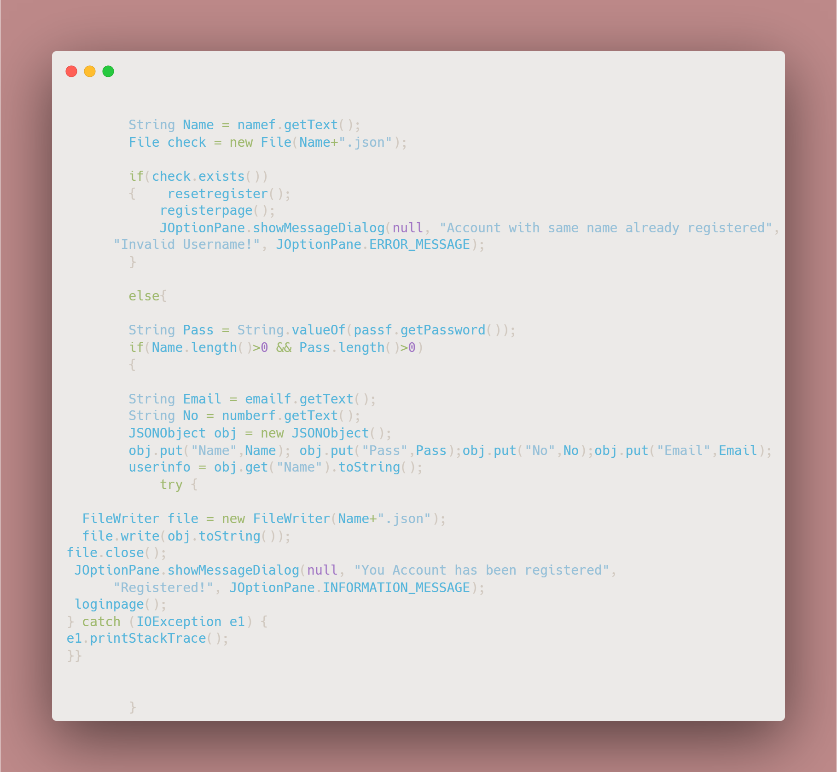
Register
The Register button makes sure the a Safe JSON file is created by the name of user which can be accessed later on.

Slide 6
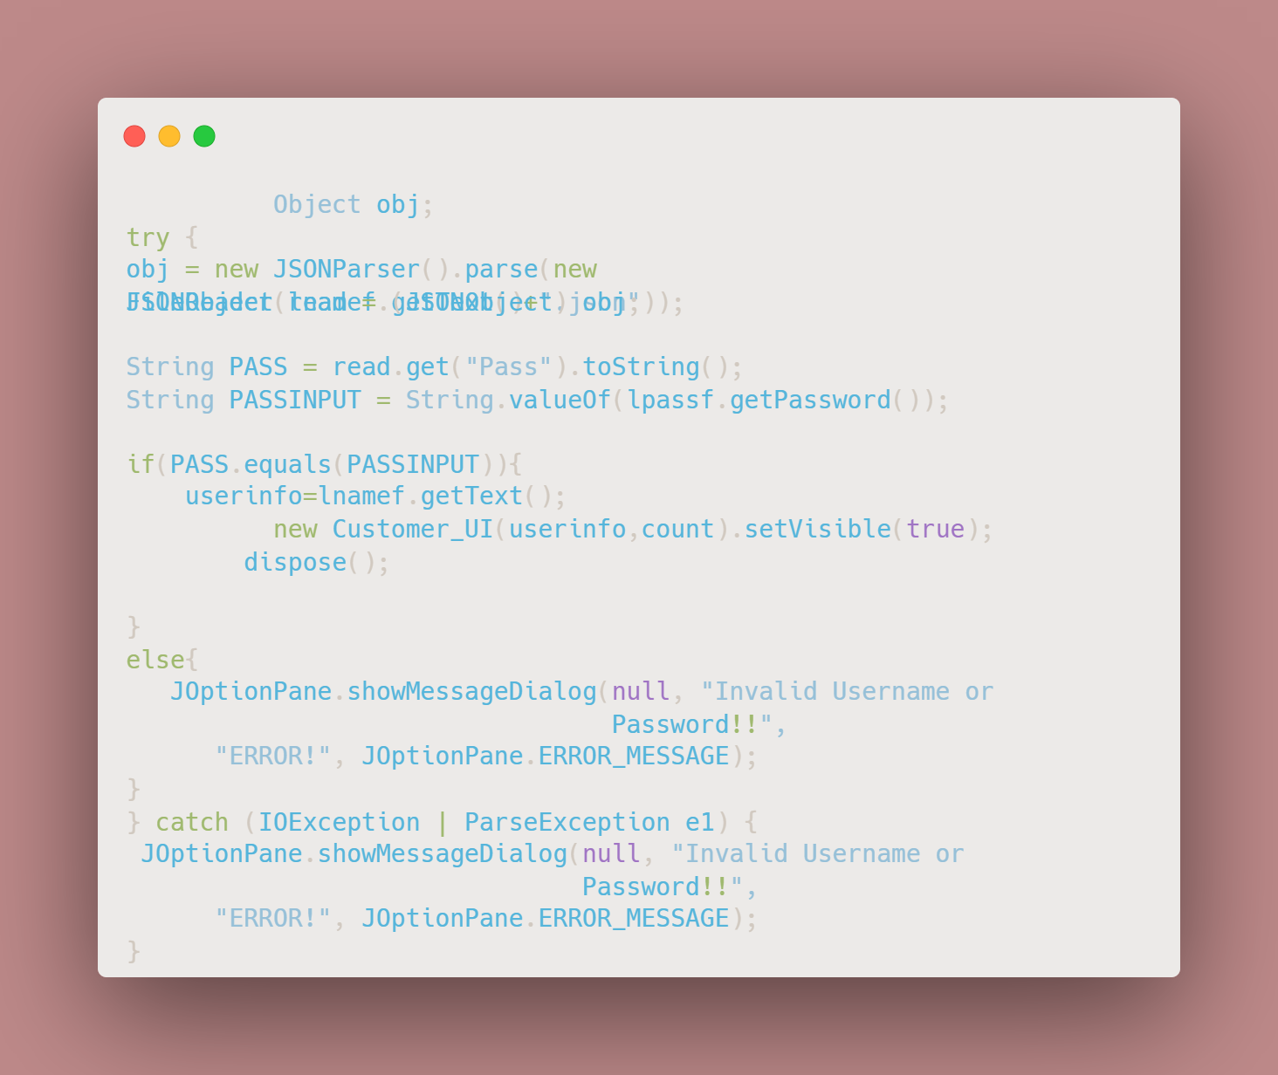
Sign in
The Login button matches the password and username field with json files to check wether the login credentials are correct

Slide 7
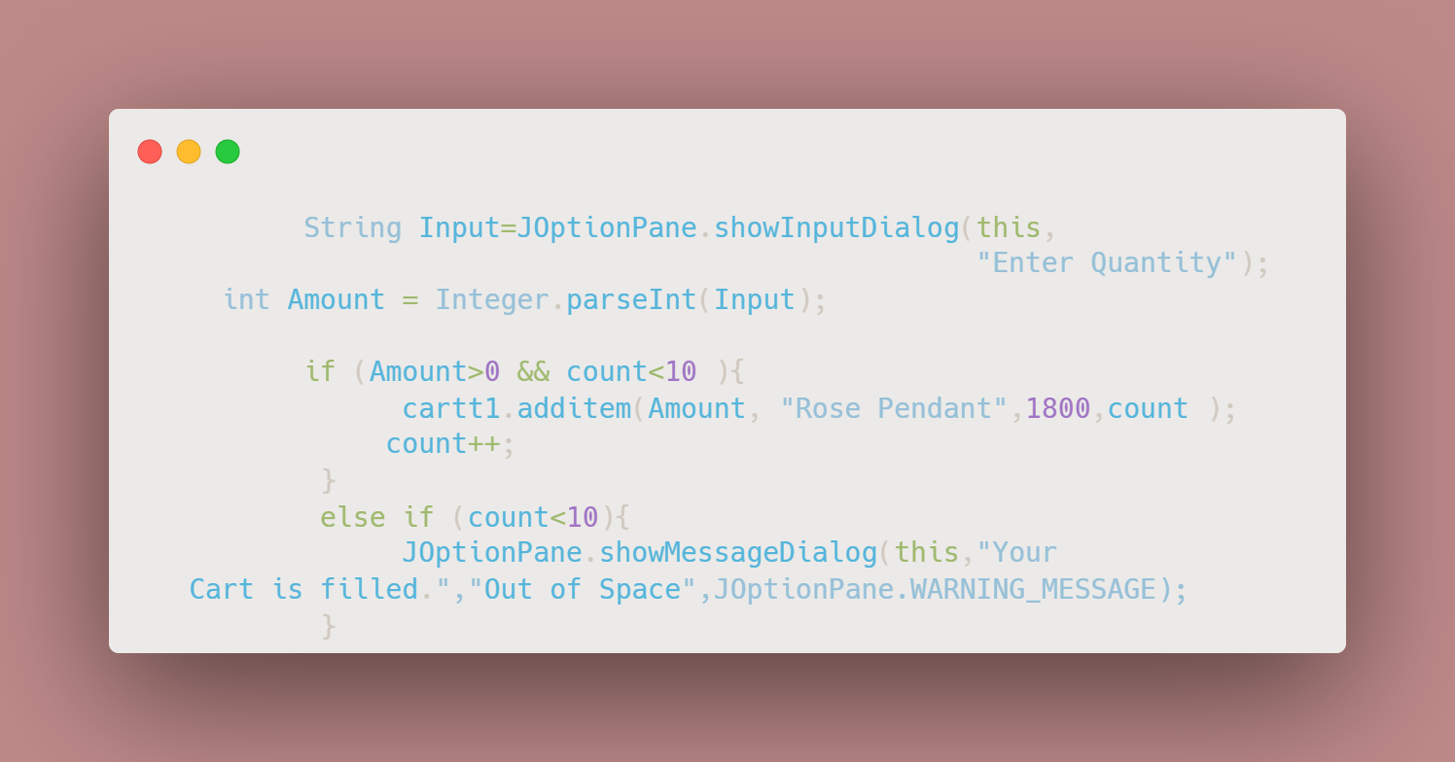
Panels
Panels are used throughout the program to represent items and upon pressing are asked for amount of item,
Then the price, name and amount of item is saved in the thread i.e. cartThread

Slide 8
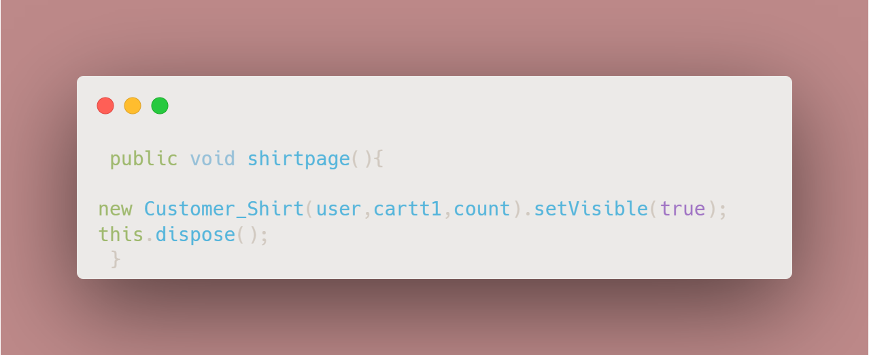
Change page
This Method and the methods similar to this are used to generate the other pages of the program i.e pants,shirts,jewellery etc.

Slide 9
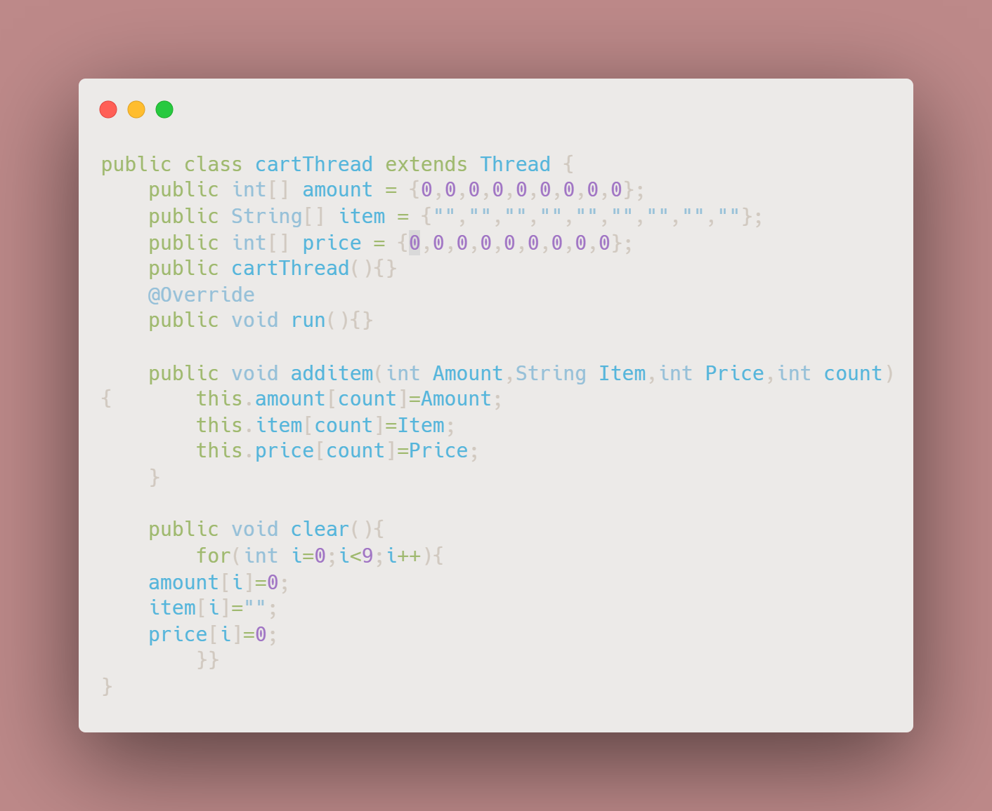
CartThread
This thread keeps the name, price , amount and the sequence of the items added to the cart in order

Slide 10
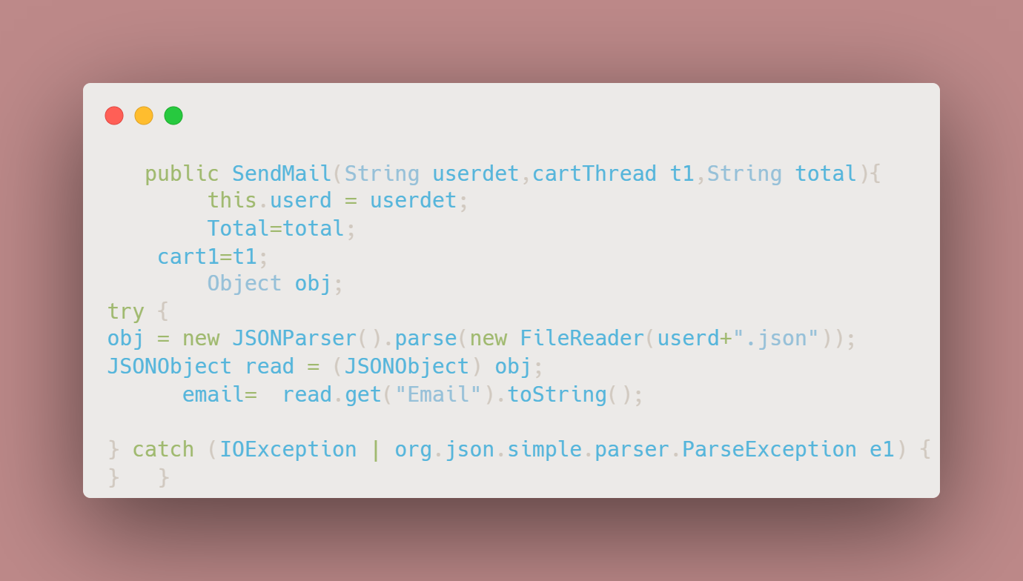
SendMail
The constructor for sendmail receives the information from Cart and fetches the email from the json file of the user and gets all the details in place in order to send the receipt email to the customer

Slide 11
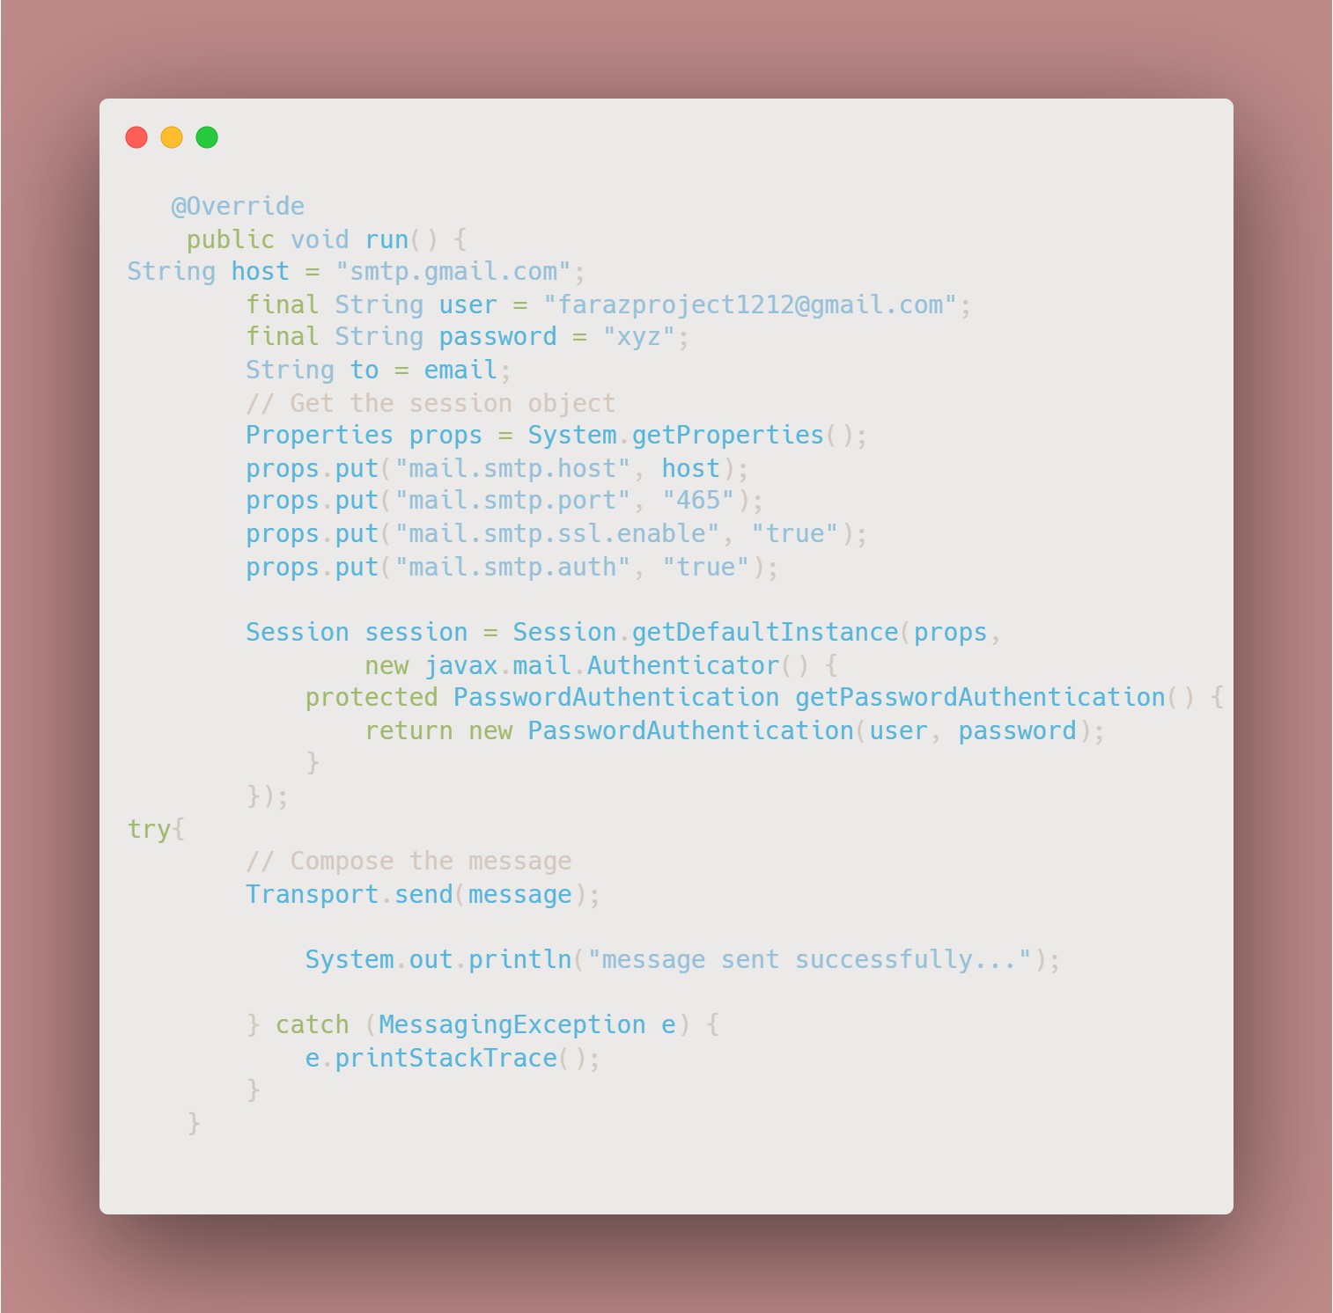
SendMail
The run method sets up the java mail api and accesses the email account of our company in order to send the mail. Then a txt file is created as a receipt which is attached to the email before the message is transported

Slide 12
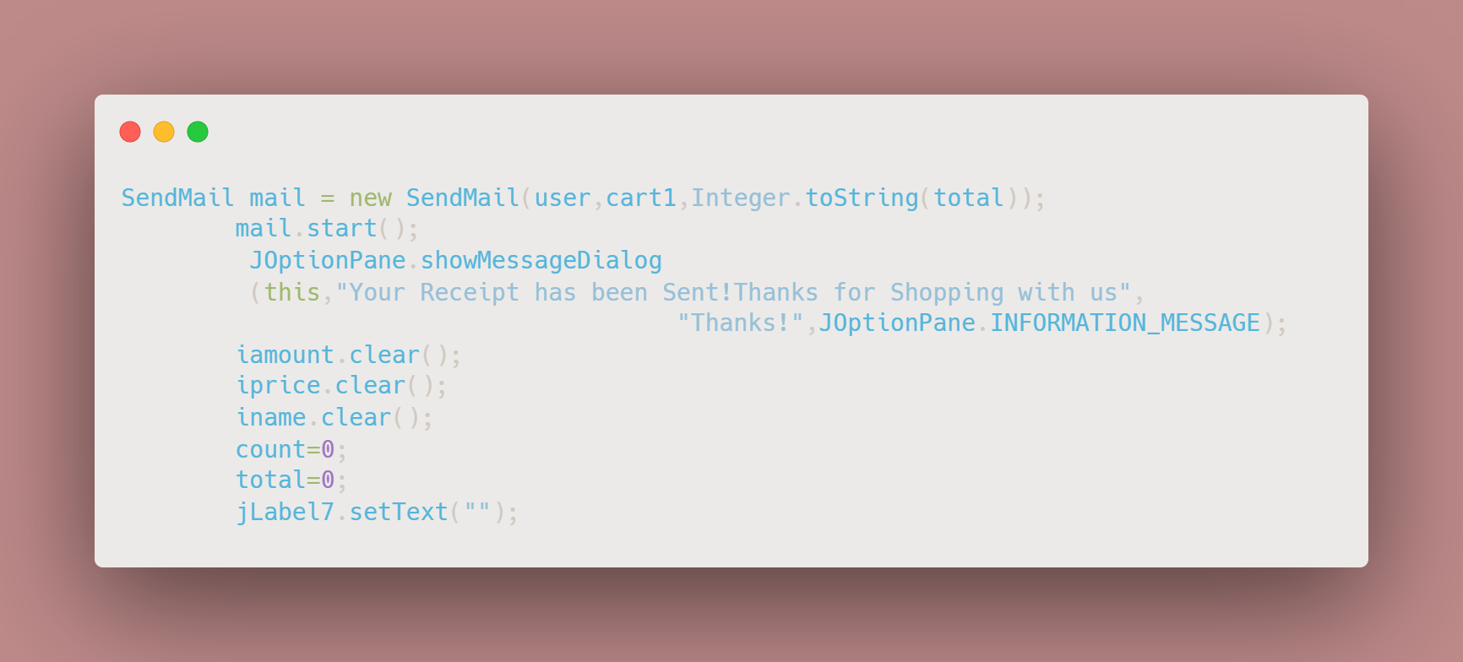
Purchase
This buttons helps us start the SendMail thread and then clears all the values so that the program may be ready for another purchase

Slide 13
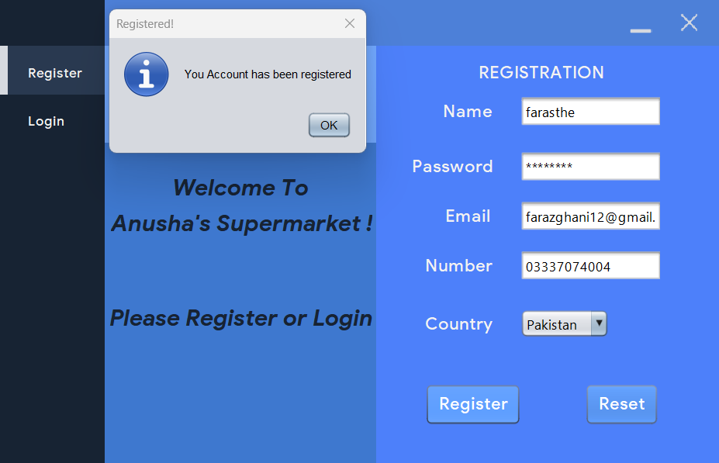
Usage
Lets Test the program and
order some items! But first we need
To create an Account.
After putting in the credentials our
Account is successfully registered!

Slide 14
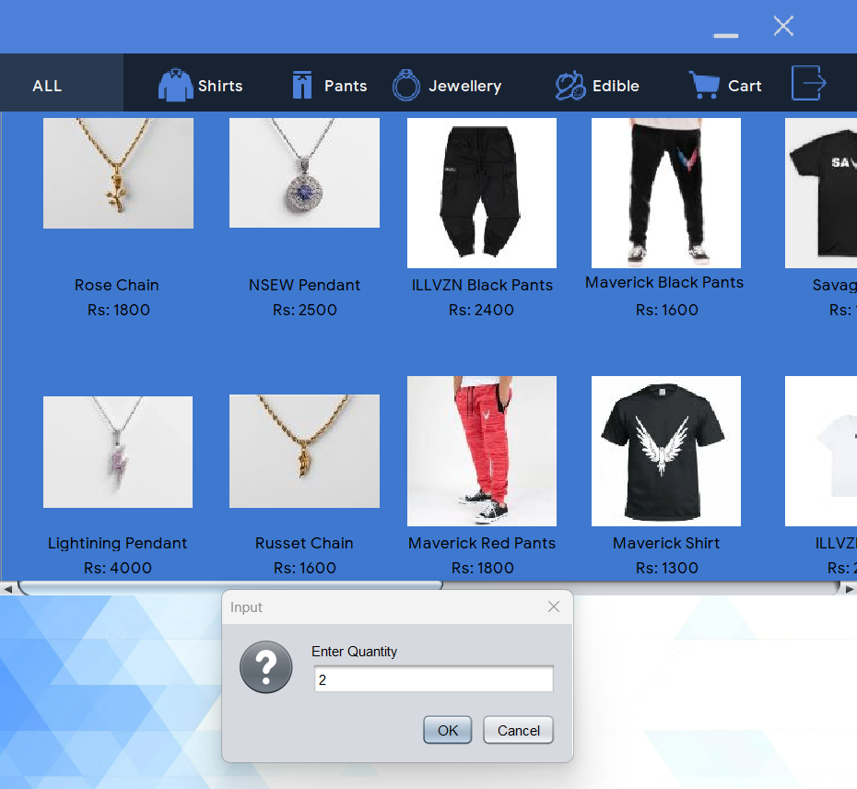
Usage
A json file by the name of farasthe.json has been created After logging in and accessing our account we are greeted with many items available for purchase ,
Lets buy two maverick T-Shirt.

Slide 15
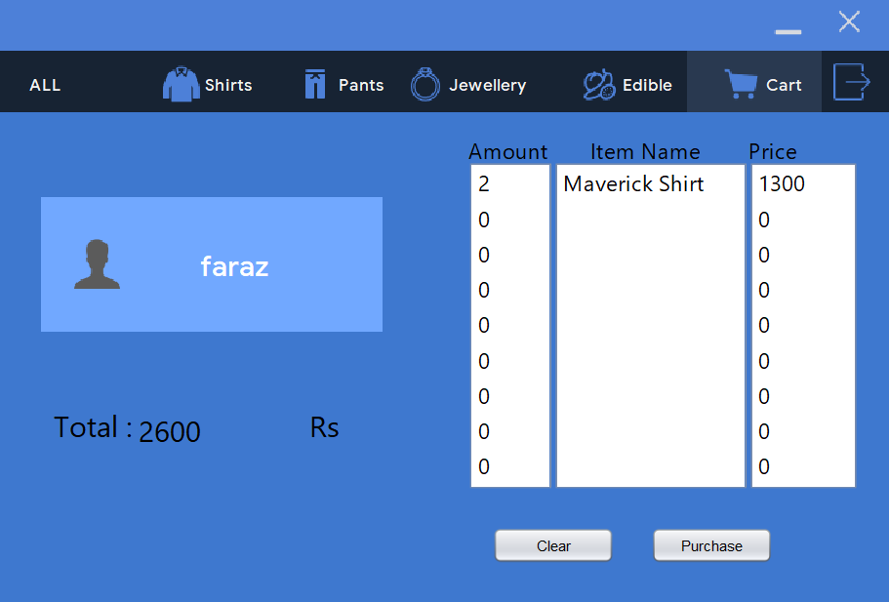
Usage
Lets checkout and see how much the total is and purchase these shirts !

Slide 16
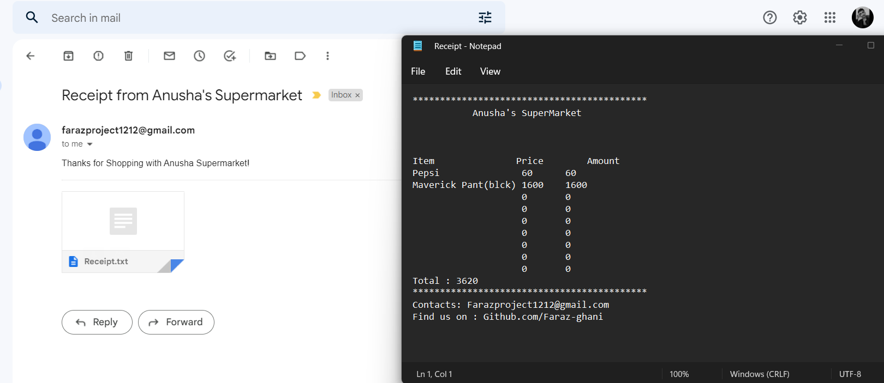
Usage
Look at that! I have received a Mail from Anusha’a Supermarket ! Let make sure the receipt has correct information.

Slide 17

Thank You!
That’s all that Anusha’s Supermarket has to provide as of now! Hope you enjoy the experience.

